Slide 1
Software Engineering with Humans and Machine Learning May 2021
Prof. Henry Muccini, Ph.D. Head of the Study Programs in Computer Science University of L’ Aquila, L’Aquila, Italy
henry.muccini@univaq.it - @muccinihenry

Slide 2
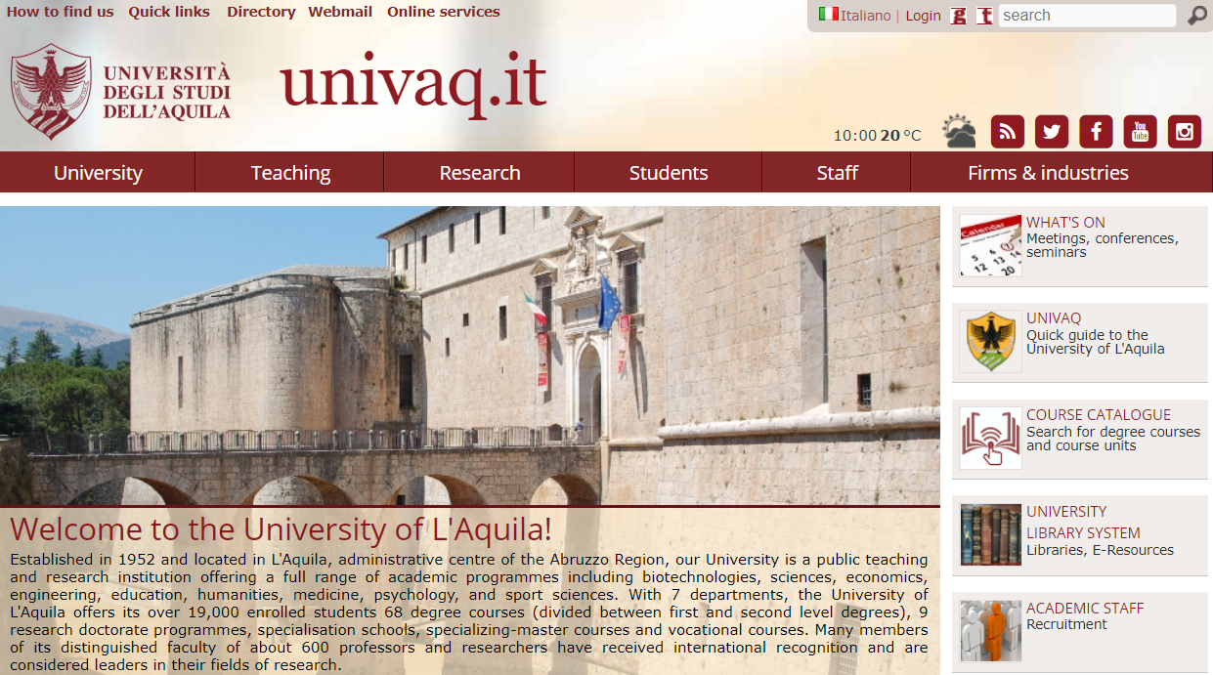
Who am I?
Professor in Software Engineering
@Department of Engineering, and Computer Science, and Mathematics
Start-up
Spin-off company of the University of L’Aquila

Slide 3
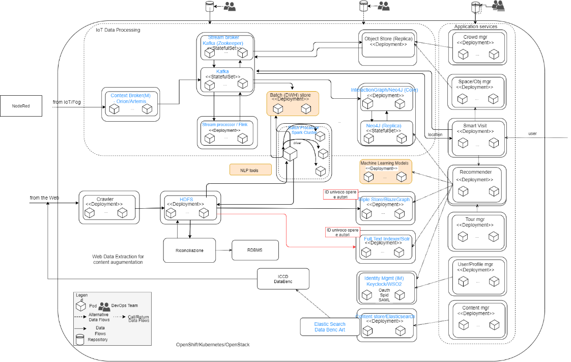
Who am I?
Architecting complex systems
Professor in Software Engineering
@Department of Engineering, and Computer Science, and Mathematics
Multi-site crowd management
Start-up
Spin-off company of the University of L’Aquila

Slide 4
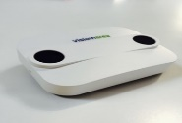
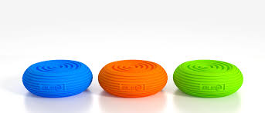
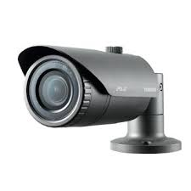
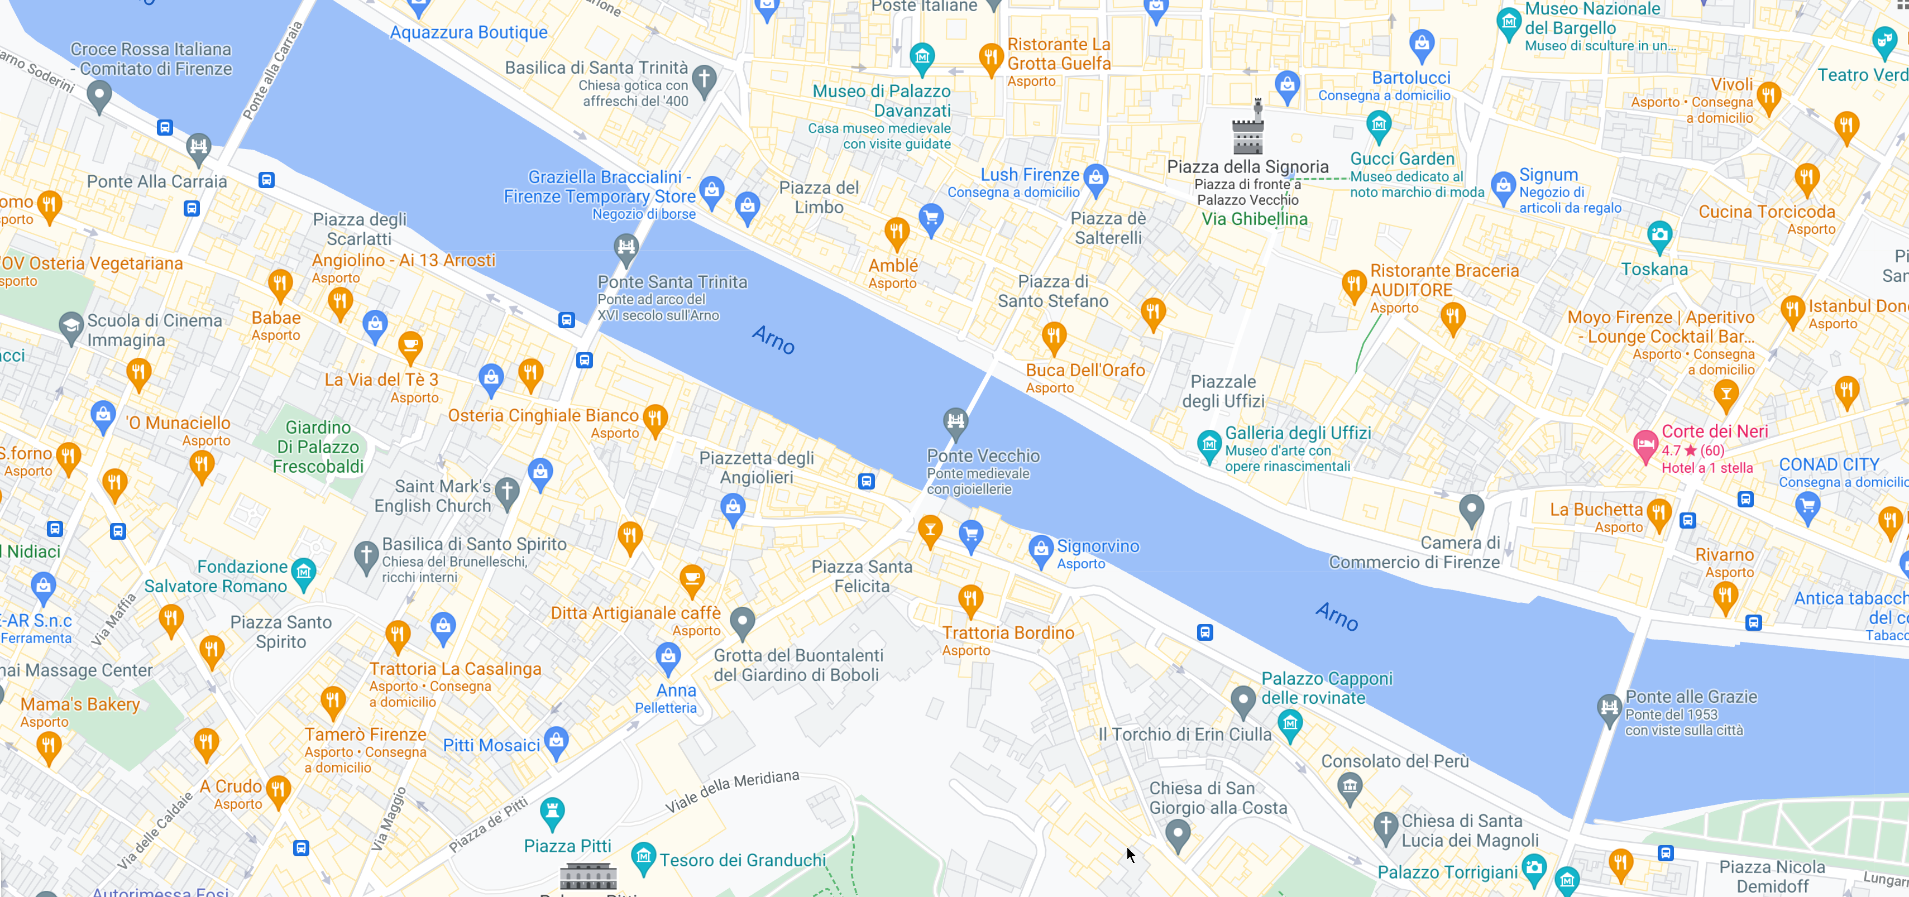
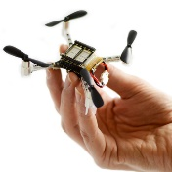
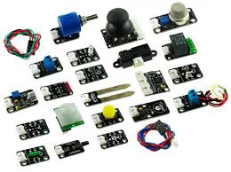
Cyber Physical Space

Slide 5
Adaptive Software Architecture & Machine Learning
How to connect HW/SW components?
How to optimize QoS based on the real usages?
How to intelligently discover microservices?
How to self-adapt the system so to maximize QoS?
Cyber Physical Space

Slide 6
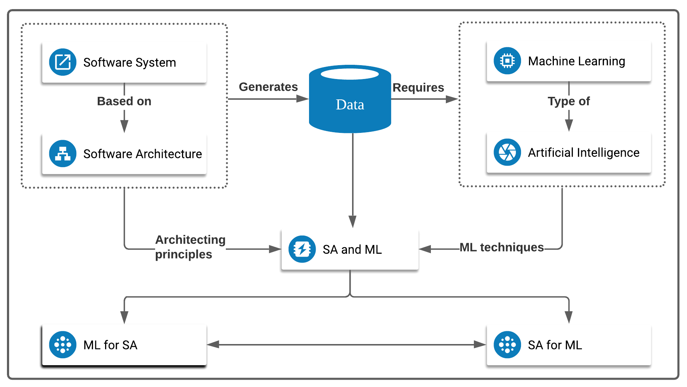
Adaptive Software Architecture & Machine Learning

Slide 7
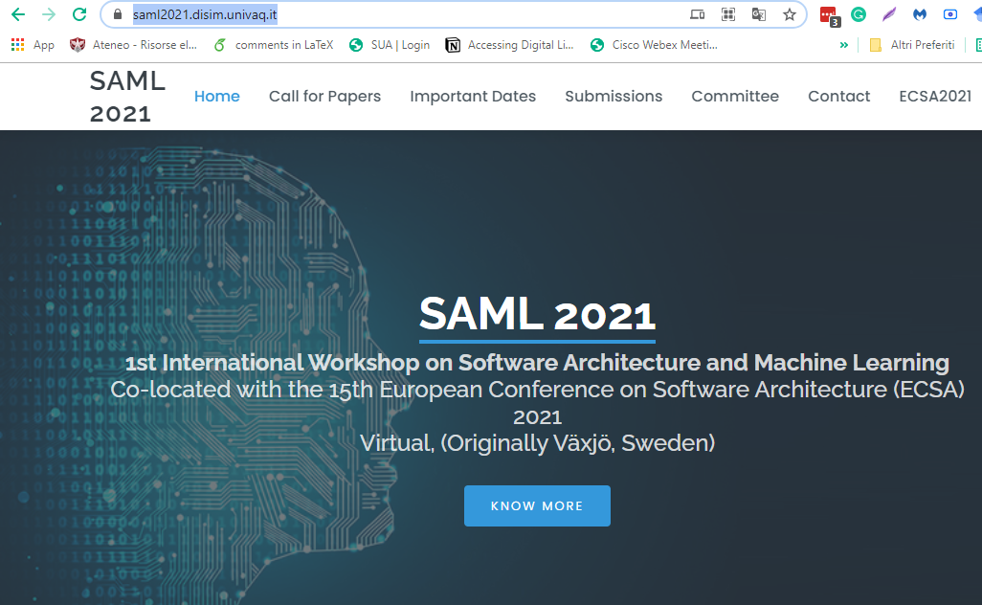
Adaptive Software Architecture & Machine Learning
https://saml2021.disim.univaq.it/
Javier Cámara, Henry Muccini, Karthik Vaidhyanathan: Quantitative Verification-Aided Machine Learning: A Tandem Approach for Architecting Self-Adaptive IoT Systems. ICSA 2020: 11-22
Martina De Sanctis, Henry Muccini, Karthik Vaidhyanathan: Data-driven Adaptation in Microservice-based IoT Architectures. ICSA Companion 2020: 59-62

Slide 8
Cyber Physical Space

Slide 9
Internet of Behaviors - IoB
”The IoB is about using data to change behaviors” [GartnerIoB]
People centricity
Location independence
Resilient delivery
[GartnerIoB] https://www.gartner.com/smarterwithgartner/gartner-top-strategic-technology-trends-for-2021/

Slide 10
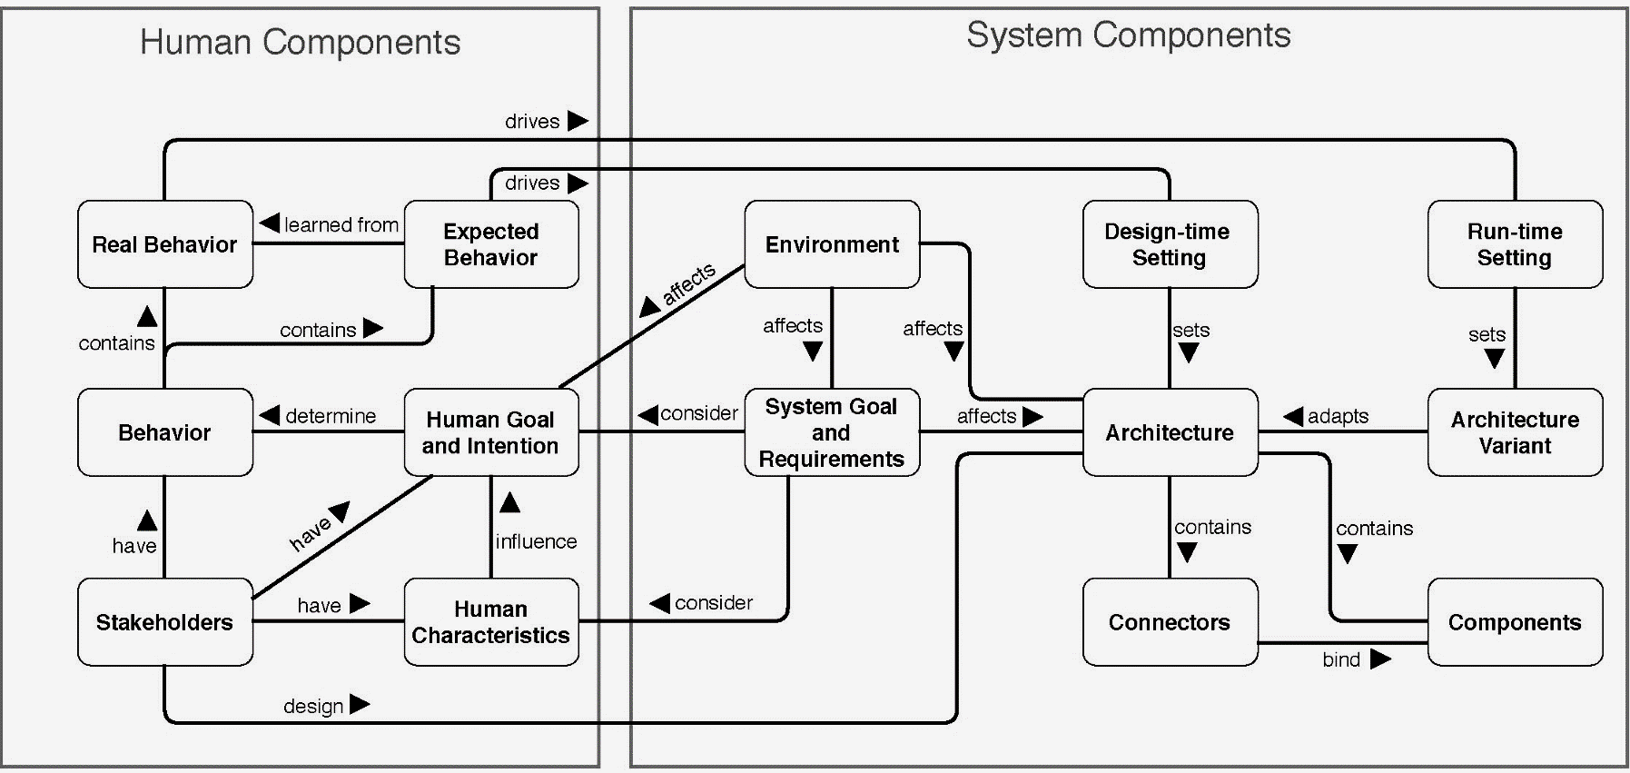
Architecting the IoB
Designing Internet of Behaviors Systems: From Experts’ View to a Conceptual Model. Submitted for publication.
Mahyar T. Moghaddam, Henry Muccini, and Julie Dugdale.
Human behaviour centered design: developing a software system for cultural heritage. ICSE-SEIS 2020: 85-94 Julie Dugdale, Mahyar Tourchi Moghaddam, Henry Muccini.
IoT4Emergency: Internet of Things for Emergency Management. ACM SIGSOFT Softw. Eng. Notes 46(1): 33-36 (2021). Julie Dugdale, Mahyar Tourchi Moghaddam, Henry Muccini.

Slide 11
Software Engineering with Humans and Machine Learning May 2021
Prof. Henry Muccini, Ph.D. henry.muccini@univaq.it

