Slide 1
University of the Aegean Department of Information and Communication Systems Engineering
Information Systems Laboratory
Excellence in Electronic Governance and Electronic Business Research
www.icsd.aegean.gr/is-lab
Brief Presentation

Slide 2
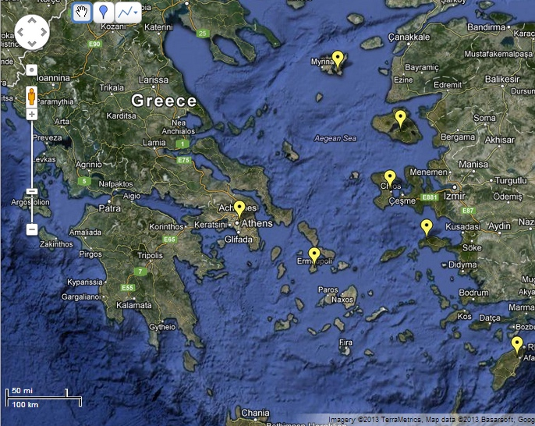
The University of the Aegean
Operates in 6 islands of the Aegean Sea (Lesvos, Samos, Rhodes, Chios, Syros, Lemnos) and Athens.
Information Technology Department is based in Samos
A young, dynamic, research oriented, innovative university
A university with a strong multi-disciplinary nature, combining mathematics, social sciences, environmental studies, management, informatics

Slide 3
The IS Lab
A multi-disciplinary research team within the Department of Information and Communication Systems Engineering, doing research and high-level consulting, internationally
A team of 15 skilled researchers (professors, post-doc, PhD and MSc students, senior engineers) with more than 50 collaborating experts in Greece and worldwide
Strong grounding on student and citizen communities (competitions, collaborative large scale lab prototypes, social media – based interaction, crowdsourcing)
Strategic alliances with research centres, industry and organisations in Greece and Europe.

Slide 4
Government and Enterprise Information Systems planning and impact assessment
Information systems and services evaluation, verification and validation
ICT-enabled governance models and Gov 2.0 methods and tools for online citizen engagement
Areas of Expertise
Service modelling, engineering, marketing
Big, Open and Linked Data
(legal data, text mining, HPC)
Simulation and visualization of complex systems, data and argumentation (AI bots)
Cloud Infrastructures and Semantic Interoperability
Government transformation and BPR

Slide 5
SUNY, Albany US
Microsoft, US
NIST, US
IBM, IL - US
Berekley - US
SINTEF
KTH
Google
STFC
TU Delft
FhG-FOKUS
INTRASOFT
SAP
EPFL
CeGD
UNINOVA
ISMB
UPV
CNR
ENGINEERING
Uni
Aegean
Syria
Israel
Collaborating Centres of Excellence in eGovernment & eBusiness
Palestine
Countries with user organisations

Slide 6
Key Partners in Greece
ATHENS UNIVERSITY
OF ECONOMICS &
BUSINESS
NATIONAL
TECHNICAL
UNIV. ATHENS
UNIVERSITY OF
PELOPONNESE
Ministry of
Interior
Ministry of
Finance
Union of
Municipalities
Federation
of ICT
Industries
Union of
Prefectures

Slide 7
University of the Aegean Department of Information and Communication Systems Engineering
Information Systems Laboratory
PART III: What we can do together
www.icsd.aegean.gr/is-lab

Slide 8
Scenario I: EU funded Research Projects
Joint participation in a European Research project, in the areas of Information and Communication Technologies (through a European, US-based or other legal entity)
Typically EU funds 70- 100% of the research – the rest 50% is provided by the participants own efforts
A typical project may have 5-15 partners, and a budget of 2-3 mil EUR for a duration of 2-3 years
Approval for funding is a highly competitive process

Slide 9
Scenario II: Joint Research (co-investment)
Joint development of a demonstrator for Governments or Enterprises.
A Demonstrator can be:
An application prototype, addressing a real problem in an innovative way.
A new platform / application usage scenario that can be demonstrated to government officials.
A new method or model, that can be further applied in businesses or administrations
Demonstrators (prototypes, platforms, cases) can then be further promoted by the Digital Governance Research Centre

Slide 10
Scenario III: Academic Collaboration
Creation of Joint Master Programmes (incl. Erasmus Mundus)
Data Science
AI
Digital Government
Digital Innovation and Entrepreneurship
Exchange students through Erasmus+ KA1
Summer Schools co-organization
Invited lectures at the industry / events
Joint publications

Slide 11
University of the Aegean Department of Information and Communication Systems Engineering
Information Systems Laboratory
www.icsd.aegean.gr/is-lab
info-islab@aegean.gr
Information
Systems
Laboratory
Aegean
Uni Is Lab
@AegeanIsLab

