Slide 1
Research. Innovation. Networking. Presentation by
Assoc. prof. Maja Ćukušić
Faculty of Economics, Business and Tourism, University of Split, Croatia

Slide 2
User-oriented process (re)design and information systems modelling – a case of smart city services (HRZZ-UIP-2017-7625)
Acronym: MIS4SC
Project manager: Assoc. prof. Maja Ćukušić
Start date: 01/01/2018
End date: 31/12/2022
Financing: Croatian Science Foundation - 131.000 €
Faculty of Economics co-financing - 36.300 €
Proposal submitted in May 2017.

Slide 3
General project objectives:
Set up and development of a research group that continues to work on the research topic beyond project lifetime.
Development of a framework for data-driven, user-oriented process (re)design and information systems modelling.
Adaptation and validation of the framework using the case of smart city services.
Forming partnerships for knowledge sharing, dissemination and sustainability of project results.

Slide 4
Three research ‘directions’:
New research directions in the field of digital transformation: Business Process Management (BPM) and Customer eXperience (CX) convergence
Trends in using smart technologies for Customer eXperience (CX) management and for data-driven modelling and development of user-oriented information systems.
Modelling user-oriented information systems in smart city environments.

Slide 5
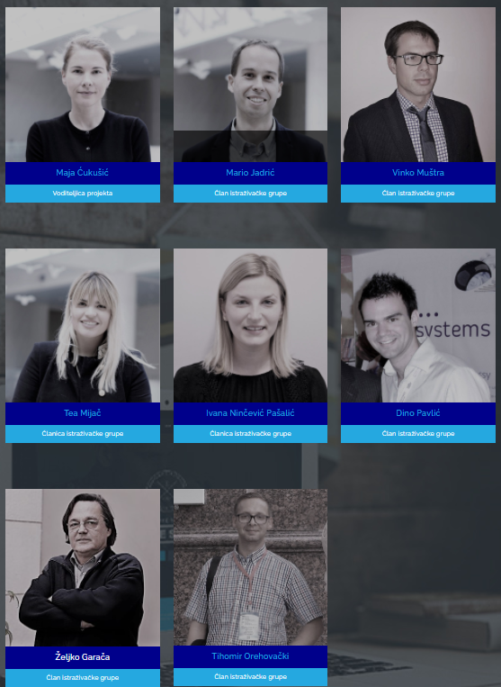
Team
Assoc. prof. Maja Ćukušić, University of Split, Faculty of Economics
Assoc. prof. Mario Jadrić, University of Split, Faculty of Economics
Assoc. prof. Vinko Muštra, University of Split, Faculty of Economics
Ivana Ninčević Pašalić, PhD candidate, University of Split, Faculty of Economics
Tea Mijač, PhD candidate, University of Split, Faculty of Economics
Dino Pavlić, PhD candidate, Typequast NL
Prof. dr. Željko Garača, University of Split, Faculty of Economics
Prof. dr. Kawa Nazemi, Darmstadt University of Applied Sciences
Assist. prof. Anton Manfreda, University of Ljubljana, School of Economics and Business (SEB LU)
Assoc. prof. Tihomir Orehovački, University Jurja Dobrile Pula

Slide 6
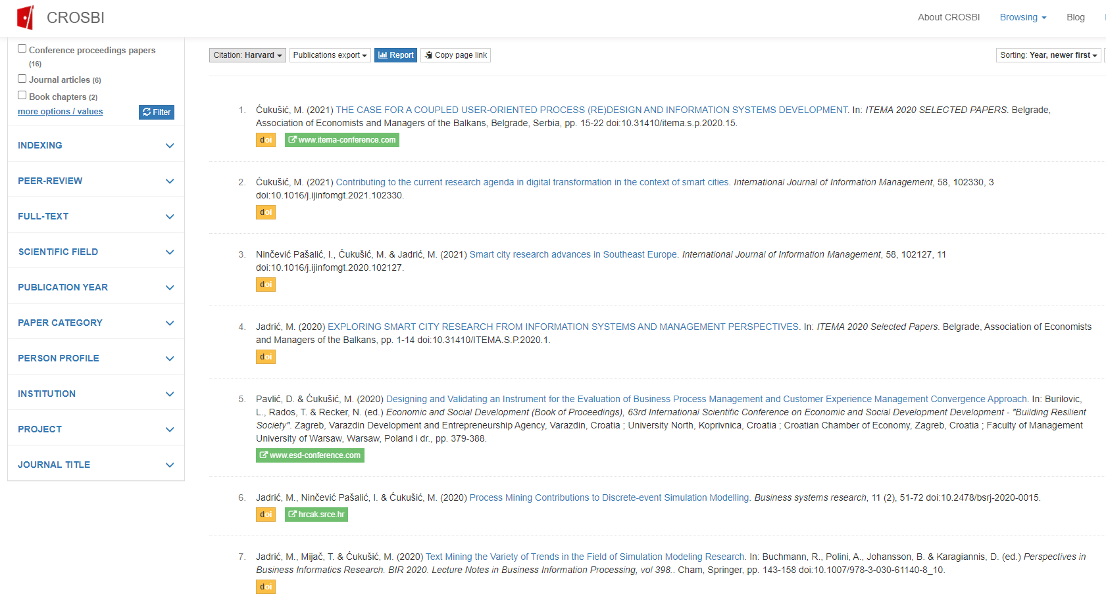
Publications
https://www.bib.irb.hr/pretraga/?operators=and|6586|text|project-id

Slide 7
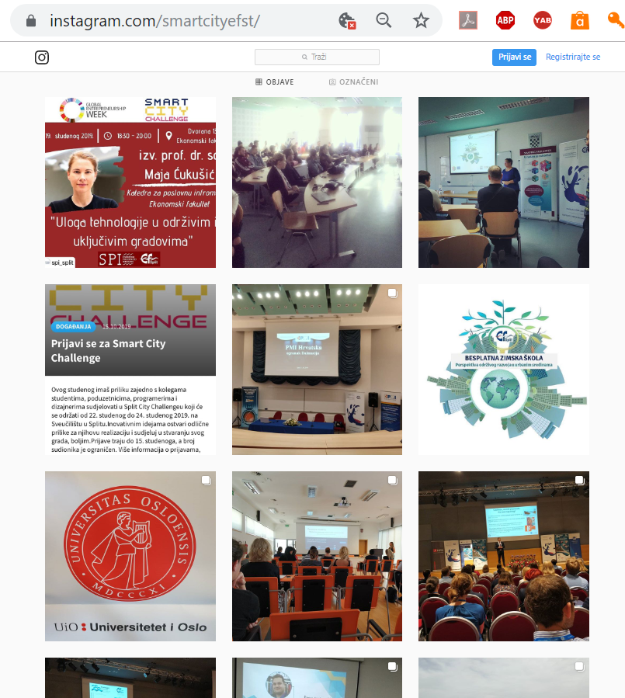
https://www.instagram.com/smartcityefst/
https://twitter.com/SmartCity_efst

Slide 8
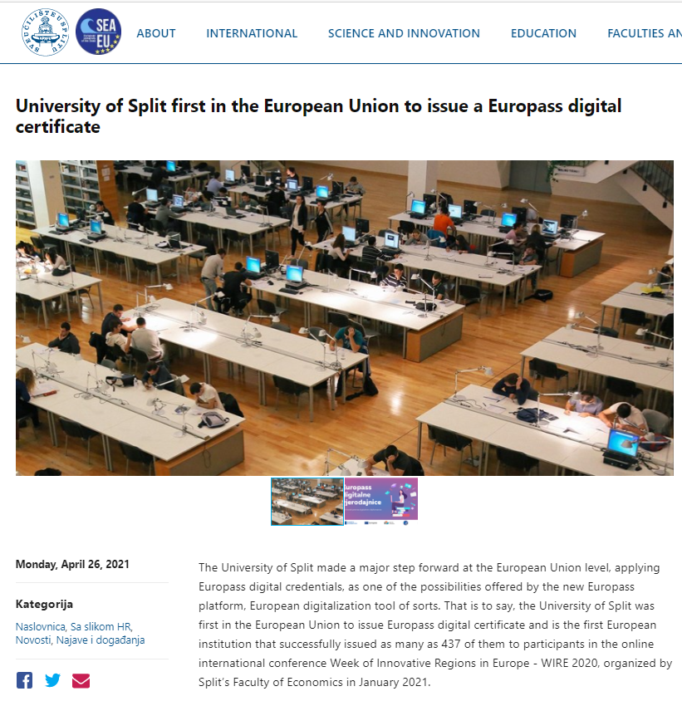
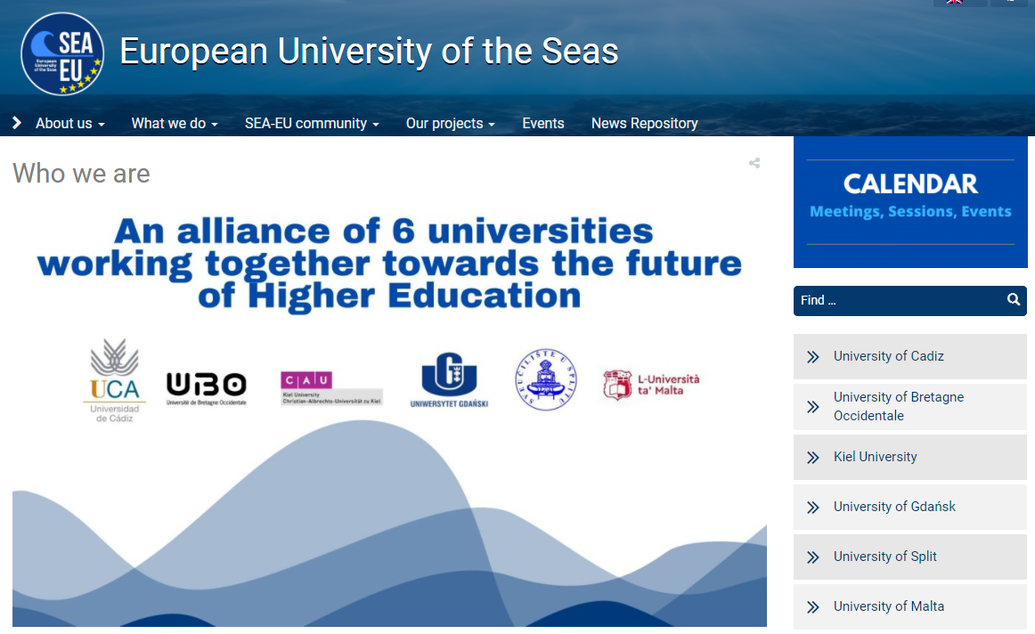
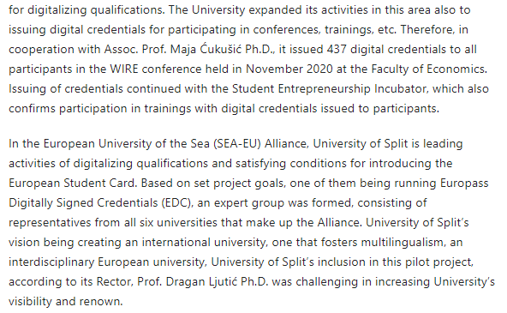
https://www.unist.hr/en/news/university-of-split-first-in-the-european-union-to-issue-a-europass-digital-certificate

Slide 9
Thank you!
Maja Ćukušić
maja.cukusic@efst.hr
This work has been supported by the Croatian Science Foundation under the project UIP-2017- 05-7625.

